Slide 1
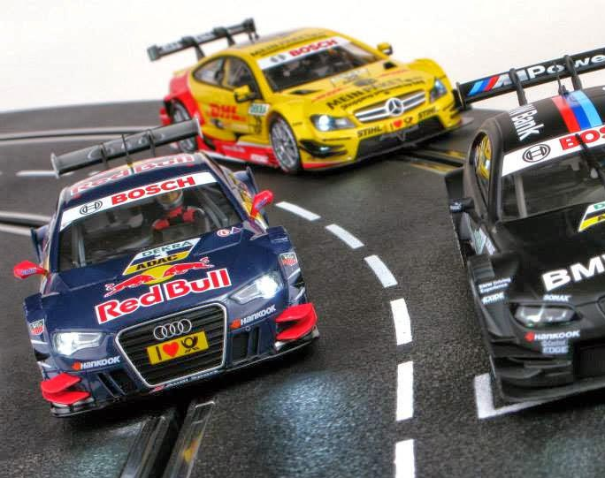
Using HTM to Perform Misbehavior Detection in Autonomous Vehicle Platoons
Ethan Swistak and Tushar Singhal

Slide 2
Week 3 – Progress Summary
Completed This Week | To-Do
Optimized HTM hyperparams, improved results. Implemented LSTM Autoencoder. Improved results through windowing | Use more sophisticated windowing function for LSTM and Autoencoder Pass HTM outputs to Bayesian network?

Slide 3
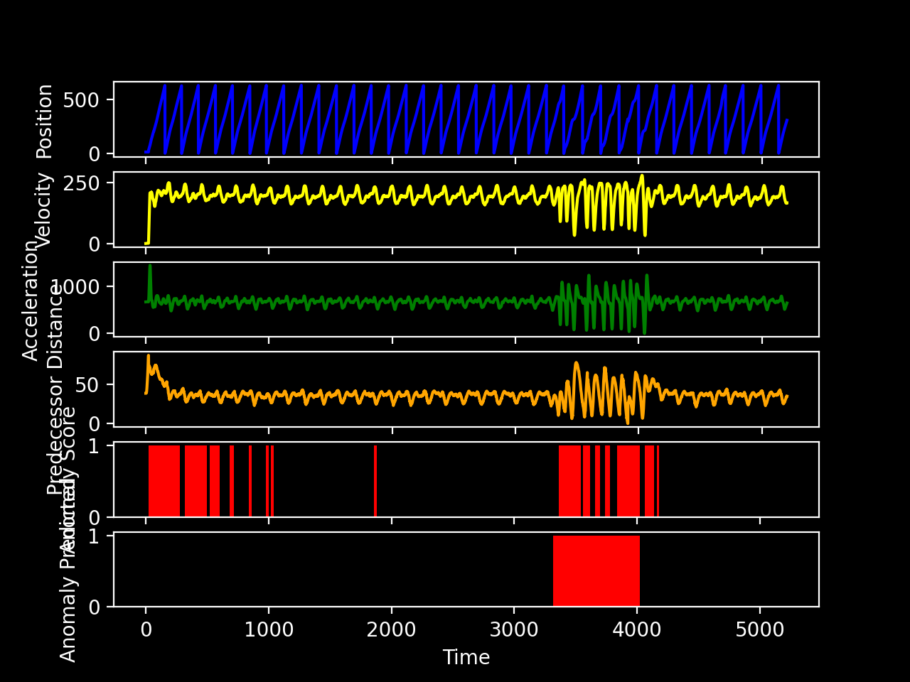
Results
Accuracy: 0.9569
Precision: 0.8095
Recall: 0.9687
F1 score: 0.8820

Slide 4
LSTM Autoencoder Architecture
_________________________________________________________________
Layer (type) Output Shape Param #
=================================================================
lstm (LSTM) (128, 7, 32) 4352
_________________________________________________________________
lstm_1 (LSTM) (128, 8) 1312
_________________________________________________________________
repeat_vector (RepeatVector) (128, 7, 8) 0
_________________________________________________________________
lstm_2 (LSTM) (128, 7, 8) 544
_________________________________________________________________
lstm_3 (LSTM) (128, 7, 32) 5248
_________________________________________________________________
time_distributed (TimeDistri (128, 7, 1) 33
=================================================================
Total params: 11,489
Trainable params: 11,489
Non-trainable params: 0
_________________________________________________________________

Slide 5
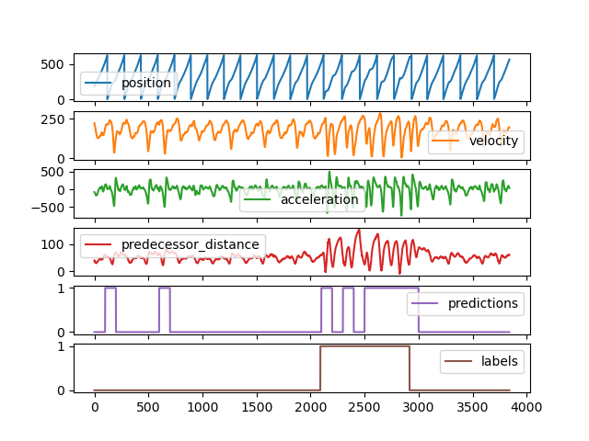
LSTM Autoencoder Results
Accuracy: N/A
Precision: 0.6844
Recall: 0.7467
F1 score: 0.7142

